Slide 1
DNS security
Notes:
Resolver
1. Answer in cache
2. Go and find out the answer
Open Resolver: Anyone can ask a question

Slide 2
How DNS works
Ask local resolver first about name->IP mapping
It returns info from cache if any
If info not in cache, resolver asks servers in DNS hierarchy that are authoritative for a given domain
Start from root, root sends it to the next point in hierarchy
End at authoritative server for the domain you are asking about (auth)
Resolver caches the replies
ARP: Address Resolution Protocol
Translates IP address to MAC address to find dst machine
DHCP: Dynamic Host Configuration Protocol
Dynamically assign self IP address
DNS: Domain Name System
Translate domain name to IP address
Notes:
ARP: Address Resolution Protocol
Translates IP address to MAC address to find dst machine
DHCP: Dynamic Host Configuration Protocol
Dynamically assign self IP address
DNS: Domain Name System
Translate domain name to IP address

Slide 3
DNS hijacking
Wait for resolver (target) to ask about a name from the victim’s domain
Provide your own reply faster than auth server
Provide some extra information (IP of auth server)
This poisons the cache at that resolver, not globally
But if the resolver is at the important/large network the victim can lose a lot of traffic to the attacker
Attacker’s goal: impersonate the victim (phishing, stealing cookies)

Slide 4
DNS hijacking
2. It’s at IP 1.2.3.4
1. Who has www.victim.com?
target
VictimNS
attacker
3. It’s at IP 5.6.7.8
Too late!
Victim
5.6.7.8

Slide 5
Short-circuiting waiting
Ask the target resolver about some name from the victim’s domain
Doesn’t have to be the name you intend to hijack since DNS will take extra info in the reply
Asking about non-existing names guarantees they are not in resolver’s cache already
Can ask about different domains too

Slide 6
Cache poisoning 1
Hijack entire domain
IP for www.attacker.com (attacker asks target, target asks attackNS)
Don’t know, ns.victim.com is auth for victim.com, its IP is 1.2.3.4 (attackNS’s reply)
Target stores ns.victim.com -> 1.2.3.4 in cache
1. www.attacker.com?
target
VictimNS
attacker
5.6.7.8
2. www.attacker.com?
3. don’t know ns.victim.com is auth for victim.com
ns.victim.com has IP 1.2.3.4
attackNS
1.2.3.4

Slide 7
Defenses
Only accept auth if its domain is same about the domain you asked for
Don’t accept extra info in the reply if you did not ask for that info

Slide 8
Cache poisoning 2
Hijack one name
IP for www.victim.com (attacker asks target, target asks victimNS)
Attacker replies faster than the victimNS giving 1.2.3.4
Target stores www.victim.com->1.2.3.4 in cache
2. www.victim.com?
1. www.victim.com?
target
VictimNS
attacker
5.6.7.8
3. www.victim.com has IP 1.2.3.4
attackNS
1.2.3.4

Slide 9
Cache poisoning 3
Hijack entire domain
IP for madeup.victim.com
Attacker replies faster than the victimNS
… ns.victim.com is auth for victim.com, its IP is 1.2.3.4
Target stores ns.victim.com->1.2.3.4 in cache
2. www.victim.com?
1. www.victim.com?
target
VictimNS
attacker
5.6.7.8
3. madeup.victim.com has IP 1.2.3.4 ns.victim.com is auth for victim.com
ns.victim.com has IP 1.2.3.4
attackNS
1.2.3.4

Slide 10
Being faster is not enough
DNS requests come from a random source port (UDP header) and have a random request ID (DNS header)
Target will only accept replies that
Come to the port from which requests are sent
Come with the replyID same as the requestID
Attacker does not see target’s requests
Can try to sniff the info
Can try to guess the info
If the resolver accepts the reply, it will accept extra info in reply too even if it has a different version in cache

Slide 11
ARP vs DNS hijacking
ARP maps IPs to MAC addresses, DNS maps names to IPs
ARP will take unsolicited replies, DNS will not
ARP replies just need to be faster
DNS replies need to:
Be faster
Match source port and request ID of the requester
Both ARP and DNS will take gratuitous info into cache:
ARP takes it from unsolicited replies
DNS takes it from extra information in the replies

Slide 12
Hijacking with sniffing
Because the attacker needs to know the right port and request ID to create winning DNS responses
He may try to sniff these from the local network if sharing this network with the target
Attacker can try to ARP spoof to make itself MITM between the target and the switch
Attacker must be on the same subnet as the target
Position itself on the path of target’s requests
DNS traffic uses UDP and is not encrypted, easy to see port and request ID and provide appropriate reply

Slide 13
Hijacking with guessing
If target uses predictable numbers for source port and request ID attacker can perform many attacks, each time trying to guess the right port/replyID combination
Having randomness in one is not enough (2¹⁶ tries)
Need randomness in both (2³² tries)
Kaminsky attack (cache poisoning 3 + no randomness in source port)

Slide 14
Defenses
Randomize source port
Makes guessing harder but not impossible
Use DNSSEC
Replies must be signed by auth
Everyone can check signatures
Auth servers for zones sign certificates when they delegate a sub-zone (e.g. .com for example.com)
Requires clients to implement DNSSEC to verify replies

Slide 15
DNSSEC
Auth stores two more record types
RRSIG – signature for each A record
DNSKEY – public key to verify the signature
Auth inserts DS record into parent in DNS hierarchy
Like a certificate
says who is authoritative for a given subdomain and gives a signed hash of the public key (DNSKEY of auth)
Resolver sets a bit asking for DNSSEC replies
Verifies each DNSKEY using DS from the level higher in hierarchy
Verifies RRSIG of the record

Slide 16
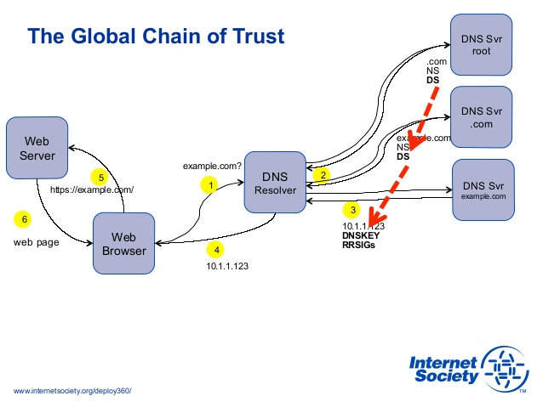
DNSSEC

Slide 17
DNSSEC
If no record exists auth returns a long reply to prove this fact
Intent was to just provide “does not exist” reply that is specific to a given query (otherwise it could be replayed to deny existence of real names)
.. and to provide it without online signing
Thus DNSSEC provides a list of all records (in a range) that would house such record if it existed
This can be misused for reflector DDoS attacks
Large amplification factor
This can be misused to map a network

